Slide 1
Chapter 8: Performance

Slide 2
What is Performance?
It is about time
Performance is about time and the software system’s ability to meet timing requirements
When events occur, the system must respond to them in time
  Events include interrupts, messages, requests from users or other systems, or clock events marking the passage of time

Slide 3
Why is Performance Important?
There are some important problems that we know how to solve with computers, but we can't solve them because we can't do them fast enough.
All systems have performance requirements, even if they are not stated explicitly.
  A typing processor may not have any explicit performance requirements, but waiting an hour (or a minute or a second) before seeing typed characters appear on the screen is unacceptable.

Slide 4
Why is Performance Important?
Typically, once a system is built and performance is found to be insufficient, performance improvements are required.
  If performance is considered in advance when the system is designed, the size of the resource pool can be simply increased. Otherwise, your options are very limited.

Slide 5
How to measure?
A system timing log can help you determine where time is wasted, so that you can focus on improving the performance of the key parts of the system.
  It is not worthwhile to spend a lot of time optimizing for only a small performance gain.

Slide 6
Trade-Off
It has frequently compromised the achievement of all other qualities.
  Scalability, e.g., increasing your system’s capacity for work, while still performing well
  Modifiablity
  Security
  Interoperability

Slide 7
Performance General Scenario
Portion of Scenario | Possible Values
Source | Internal or external to the system
Stimulus | Arrival of a periodic, sporadic, or stochastic event
Artifact | System or one or more components in the system.
Environment | Operational mode: normal, emergency, peak load, overload.
Response | Process events, change level of service
Response Measure | Latency, deadline, throughput, jitter, miss rate

Slide 8
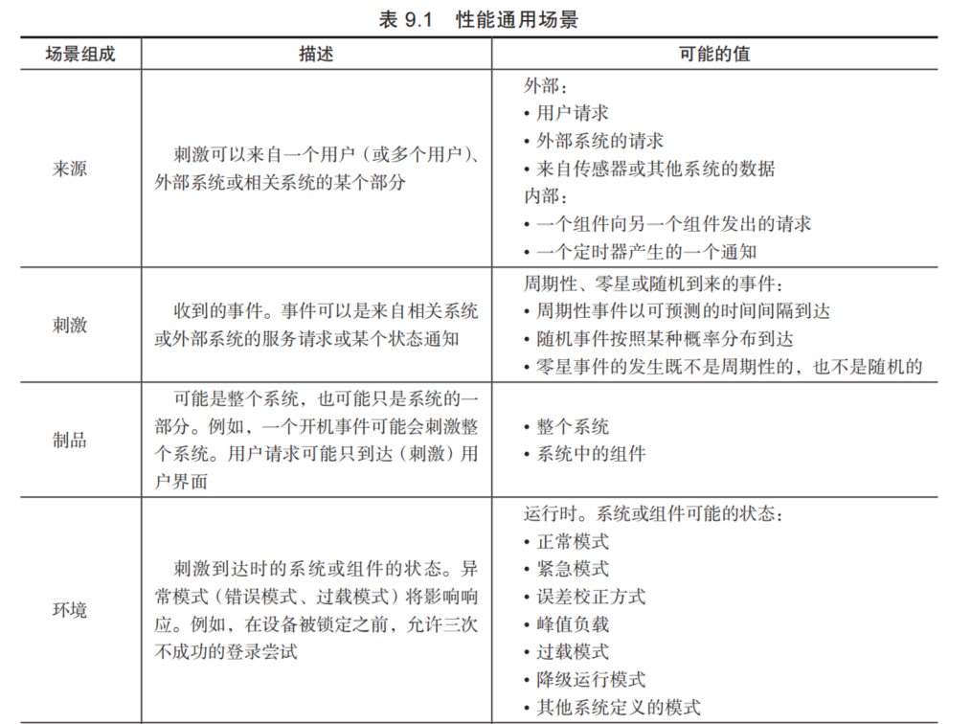
Performance General Scenario

Slide 9
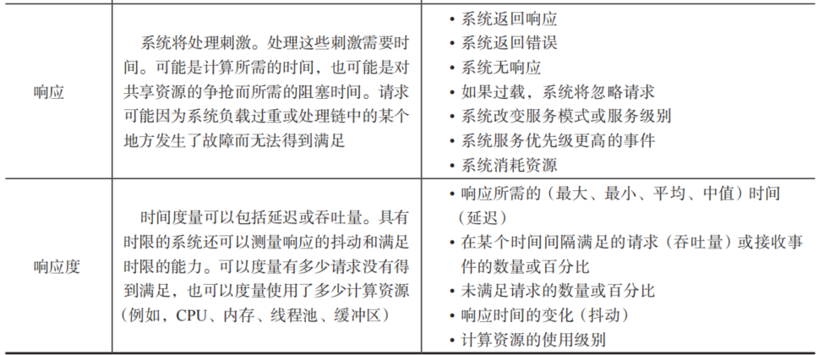
Performance General Scenario

Slide 10
Sample Concrete Performance Scenario
Users initiate transactions under normal operations. The system processes the transactions with an average latency of two seconds.
  Stimulus: transaction arrivals
  Source: users
  Artifact: the system
  Response: process the transactions
  Response measure: average latency of two seconds
  Environment: under normal operation

Slide 11
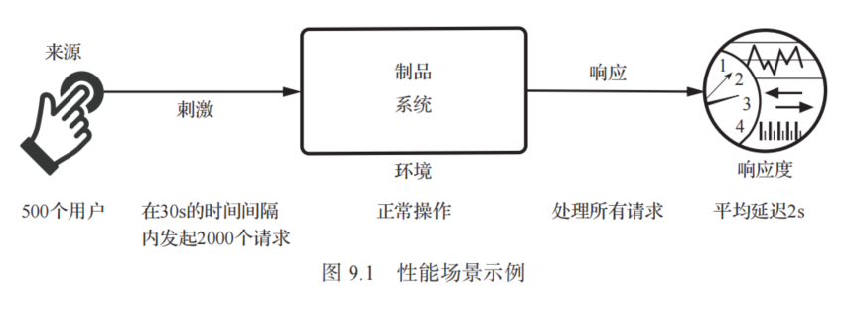
Sample Concrete Performance Scenario

Slide 12
Performance Modeling
Two basic contributors to the response time
Processing time is the time that the system is working to respond
Blocked time is the time that the system is unable to respond

Slide 13
Processing time
Suppose a message is generated by one component.
It might be placed on the network, after which it arrives at another component. It is then placed in a buffer; transformed in some fashion; processed according to some algorithm; transformed for output; placed in an output buffer; and sent onward to another component, another system, or some actor.
Each of these steps consumes resources and time and contributes to the overall latency of the processing of that event.

Slide 14
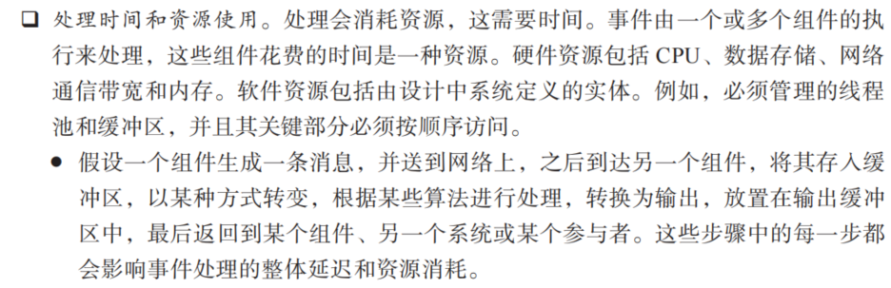
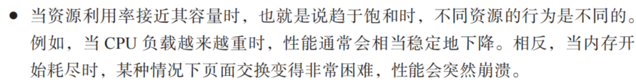
Processing time

Slide 15
Blocked time
Blocked time is caused by
  Contention for resources: Many resources can only be used by a single client at a time. This means that other clients must wait for access to those resources.
  Availability of resources: Even in the absence of contention, computation cannot proceed if a resource is unavailable.
  Dependency on other computations: it must synchronize with the results of another computation or because it is waiting for the results of a computation that it initiated

Slide 16
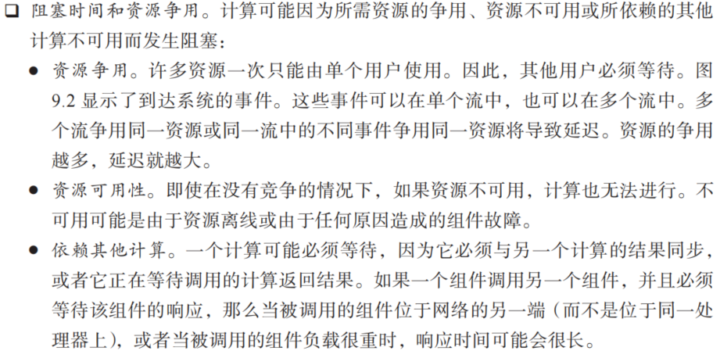
Blocked time

Slide 17
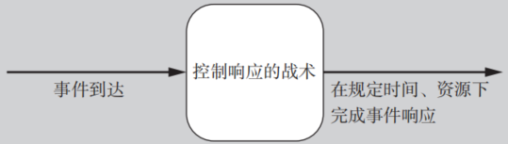
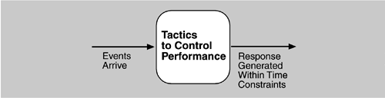
Goal of Performance Tactics
To generate a response to an event arriving the system within some time-based constraint
The event can be single or a stream, and is the trigger to perform computation

Slide 18
Two Tactic Categories
Control resource demand
  To produce smaller demand on the resources
  Operate on the demand side
Manage resources
  To make the resources at hand work more effectively in handling the demands
  Operate on the response side
Resources
  Hardware resources, e.g., CPU, data stores, network bandwidth, and memory
  Software resources, e.g., buffers, or critical sections

Slide 19
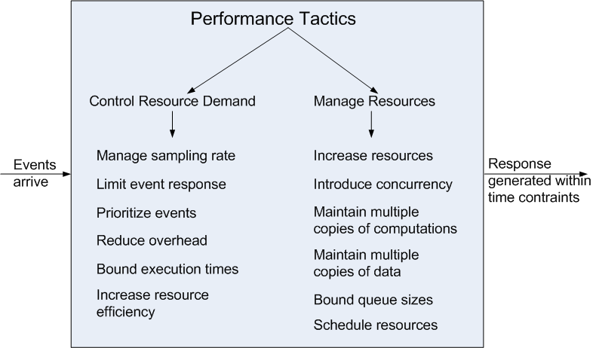
Performance Tactics

Slide 20
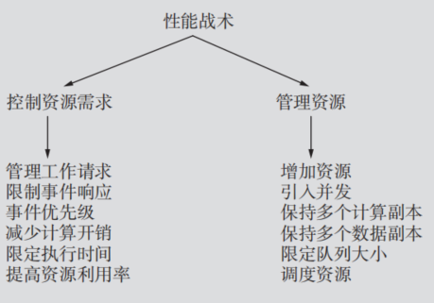
Performance Tactics

Slide 21
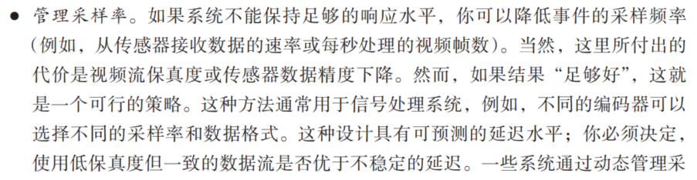

Control Resource Demand 控制资源需求
Manage Sampling Rate: to reduce the sampling frequency at which a stream of data is captured
  For example, signal processing systems; trade-off between accuracy and latency、

Slide 22
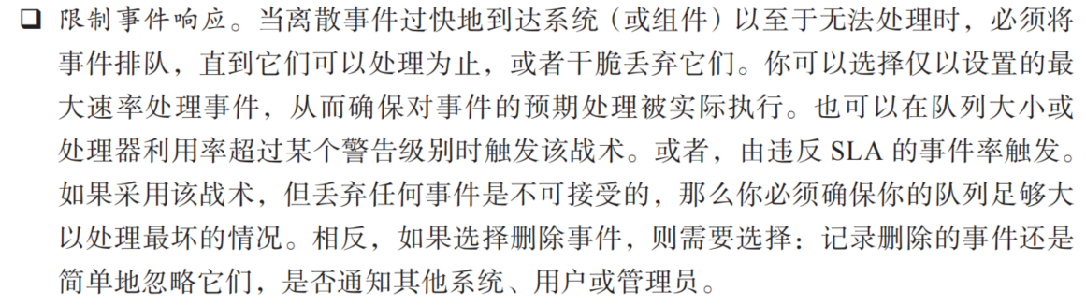
Control Resource Demand 控制资源需求
Limit event response: When discrete events arrive at the system (or element) too rapidly to be processed, then the events must be queued until they can be processed.

Slide 23
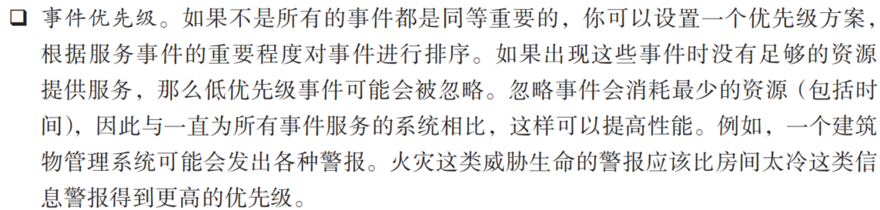
Control Resource Demand 控制资源需求
Prioritize Events: to impose a priority scheme that ranks events according to the importance
  Ignore low-priority events when resources are not enough
  For example, a building management system may raise a variety of alarms. Life-threatening alarms such as a fire alarm should be given higher priority than informational alarms such as a room is too cold.

Slide 24
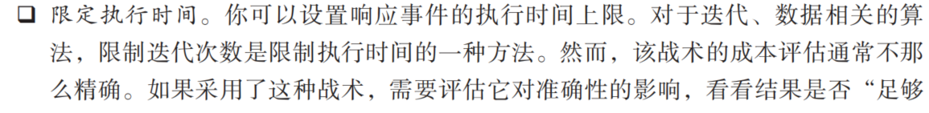
Control Resource Demand 控制资源需求
Bound Execution Times: Place a limit on how much execution time is used to respond to an event.
  In algorithm design, limiting the number of iterations is a method for bounding exec. time
  Trade-off between the performance and accuracy
    progressive, approximate

Slide 25
Control Resource Demand 控制资源需求
Reduce Overhead: The use of intermediaries increases the resources consumed in processing an event stream; removing them improves latency.
  The use of intermediaries increases the resources consumed in processing an event stream, and so removing them improves latency (Tradeoff between the modifiability and performance)
  A strategy for reducing computational overhead is to co-locate resources. Co-location may mean hosting cooperating components on the same processor to avoid the time delay of network communication

Slide 26
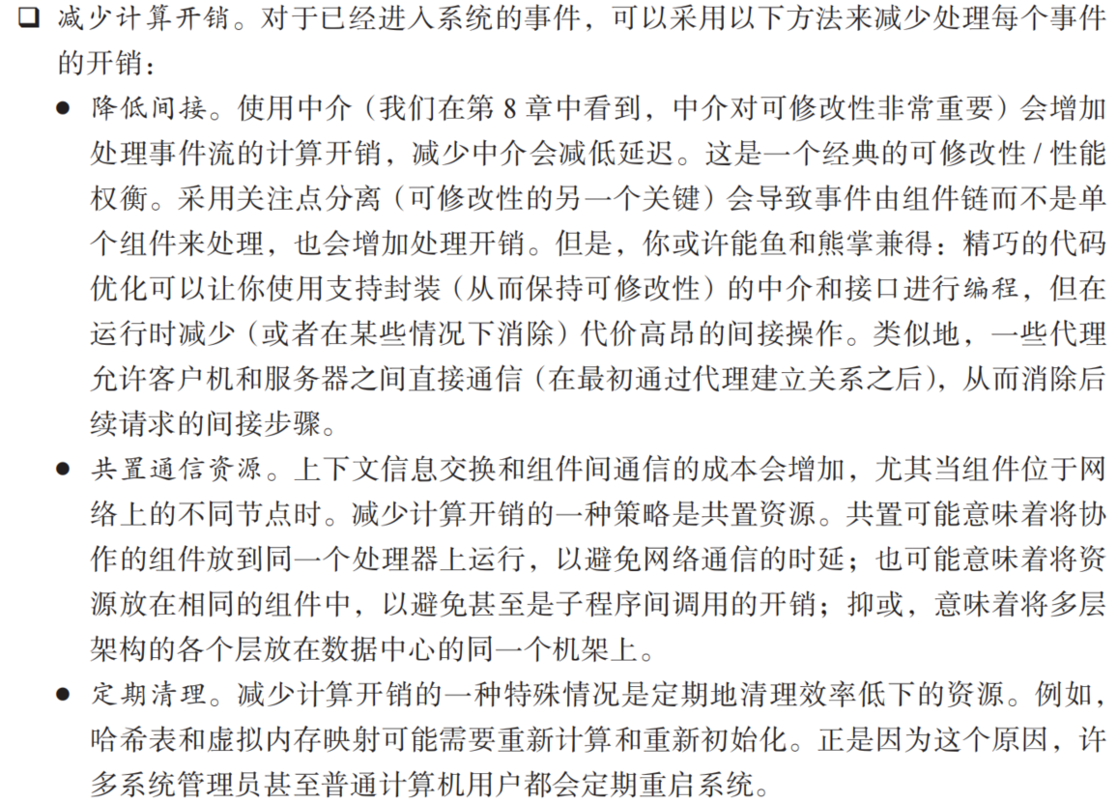
Control Resource Demand 控制资源需求

Slide 27
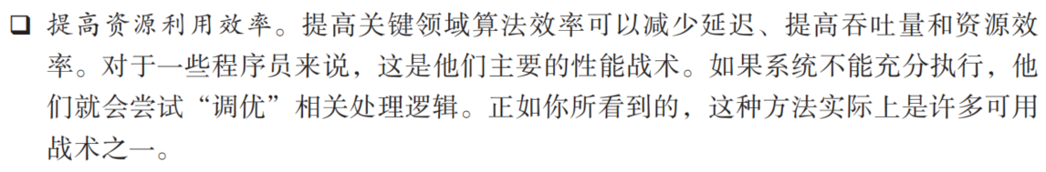
Control Resource Demand 控制资源需求
Increase Resource Efficiency: Improving the algorithms used in critical areas will decrease latency.
To reduce the complexity of the algorithm
Index

Slide 28
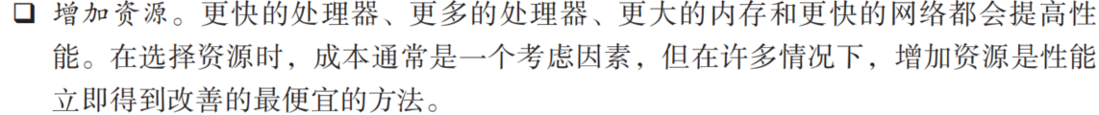
Manage Resources 管理资源
Increase Resources: Faster processors, additional processors, additional memory, and faster networks all have the potential for reducing latency.

Slide 29
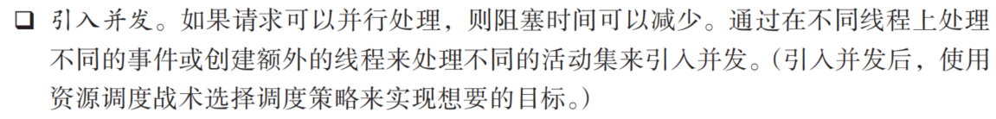
Manage Resources 管理资源
Increase Concurrency: If requests can be processed in parallel, the blocked time can be reduced.
Concurrency can be introduced by processing different streams of events on different threads

Slide 30
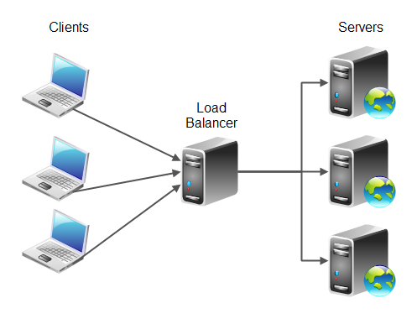
Manage Resources 管理资源
Maintain Multiple Copies of Computations：The purpose of replicas is to reduce the resource contention on a single server
Load balancer assigns new work to one of the duplicate server

Slide 31
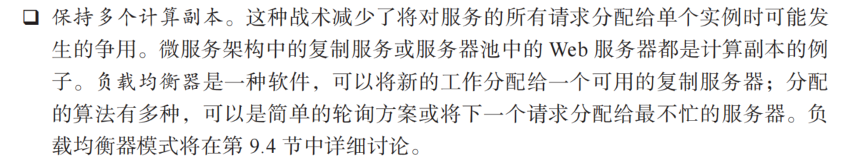
Manage Resources 管理资源

Slide 32
Manage Resources 管理资源
Data caching is to keep copies of data on storage with different access speeds.
  E.g., memory access v.s. disk access
  Local access v.s. remote access via networks
Data replication is to keep separate copies of data to reduce the contention from multiple simultaneous accesses
How to choose the data to be cached/replicated
  frequently accessed
How to guarantee the consistency of multiple copies
  Strong Consistency/Eventual Consistency

Slide 33
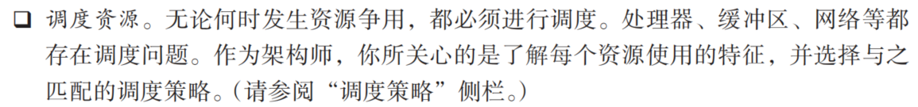
Manage Resources 管理资源
Scheduling: When there is contention for a resource, the resource must be scheduled.
  Processors needs to be scheduled
  Buffers needs to be scheduled
  Networks are scheduled

Slide 34
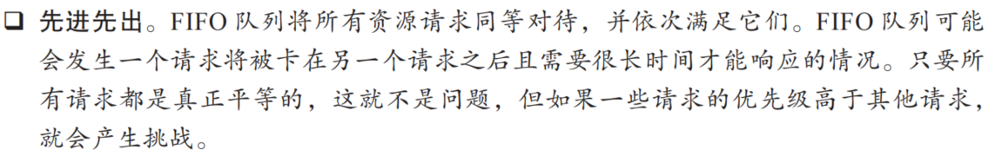
Manage Resources 管理资源

Slide 35
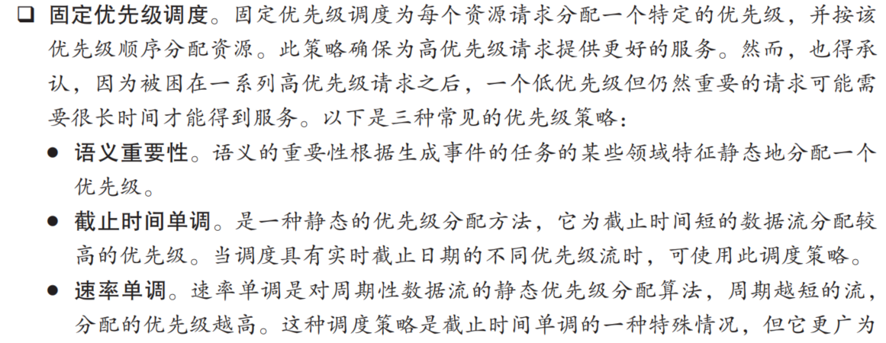
Manage Resources 管理资源

Slide 36
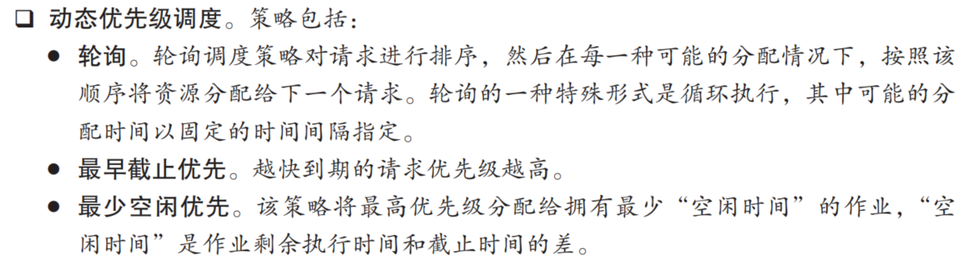
Manage Resources 管理资源

Slide 37
Performance Tactics on the Road
Manage event rate. Lights on highway entrance ramps let cars onto the highway only at set intervals, and cars must wait (queue) on the ramp for their turn.
Prioritize events. Ambulances and police, with their lights and sirens going, have higher priority than ordinary citizens; some highways have high-occupancy vehicle (HOV) lanes, giving priority to vehicles with two or more occupants.
Maintain multiple copies. Add traffic lanes to existing roads, or build parallel routes. In addition, there are some tricks that users of the system can employ:
Increase resources. Buy a Ferrari, for example. All other things being equal, the fastest car with a competent driver on an open road will get you to your destination more quickly.
Increase efficiency. Find a new route that is quicker and/or shorter than your current route.
Reduce computational overhead. You can drive closer to the car in front of you, or you can load more people into the same vehicle (that is, carpooling).

Slide 38
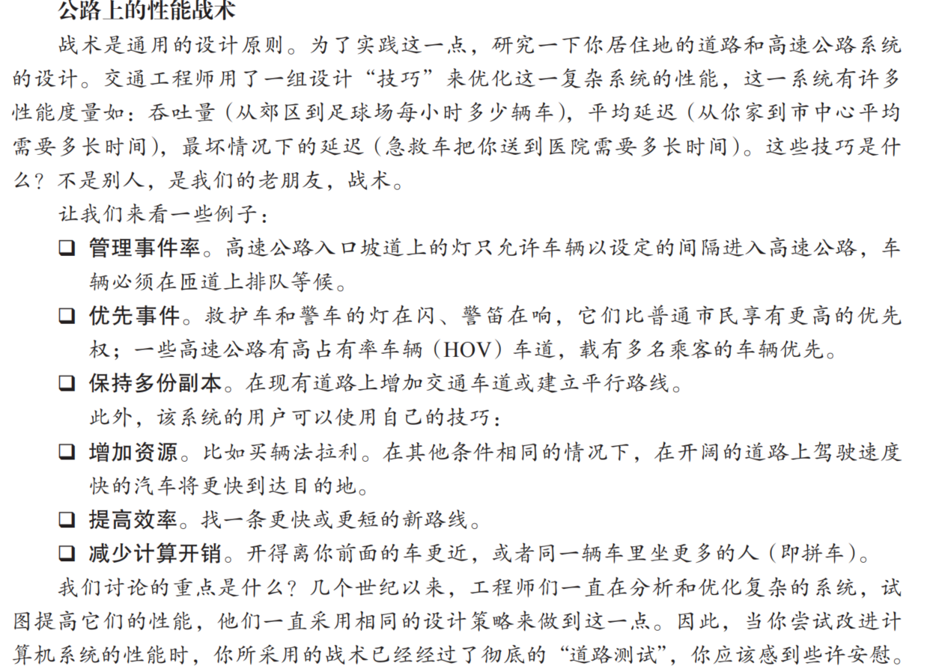
Performance Tactics on the Road

Slide 39
3-Dimension Framework for Scheduling Problem
Tasks
Resources
Objectives
调度问题 = 什么样的任务（Tasks），放在什么样的资源上（Resources），要优化什么目标（Objectives）。

Slide 40
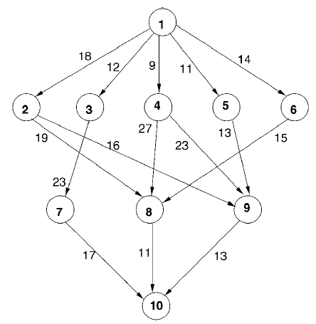
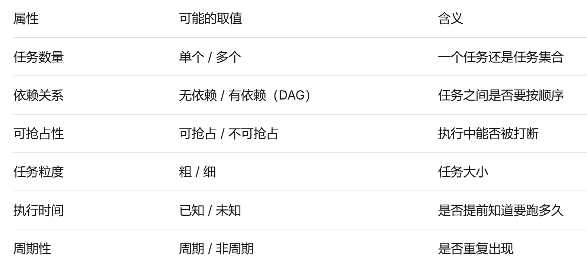
Task Model
Bag of tasks
Directed Acyclic Graph (DAG)
Periodic/cyclic tasks
Task properties
  Execution cost
  Transmission cost
  Arrival time
  Deadline
  - Preemptive or non-preemptive …

Slide 41
Resource Model
The resources include a set of machines/processors which are connected by networks
Machine/processor model
  Processing capability/speed, energy consumption
    通常涉及任务调度、负载均衡和资源分配等，提高计算效率和降低能耗
Network model
  Network topology
  Bandwidths
  Messages and energy consumption
  E.g., sensor networks, data center networks, mobile cloud
    涉及数据传输、通信效率和网络可靠性等，目的是优化数据流动和减少延迟

Slide 42
Objectives
Minimize completion time
Meeting deadline
Maximize throughput
Minimize data transmission/messages
Minimize energy consumption
...

Slide 43
Task Scheduling Problems
FIFO/FCFS
Fixed-priority scheduling
Dynamic-priority scheduling
Bag-of-Tasks scheduling on single processor
Bag-of-Tasks scheduling on multiple processors
DAGs scheduling on heterogeneous processors
Job shop scheduling

Slide 44
1. Bag-of-Tasks on Single Processor
P
Given: release time, workload of each task, or deadline
To determine when each task is executed
Objectives: average completion time of the tasks, or meeting deadlines
Notes:
First in first out.

Slide 45
1. Bag-of-Tasks on Single Processor
The execution order of tasks is important for several reasons:
1. Waiting Time
FCFS (First-Come, First-Served): Tasks are executed in the order they arrive, which can lead to longer average waiting times, especially if the first task is lengthy.
SJF (Shortest Job First): This strategy prioritizes shorter tasks, which can reduce the waiting time for subsequent tasks, generally resulting in a lower average waiting time.
2. Response Time
In scenarios requiring quick feedback, such as user interactions, choosing shorter tasks (SJF) can provide results faster, improving user experience.

Slide 46
2. Bag-of-Tasks on Multi-Processors
P
P
P
Given: release time, workload of each task
To determine where and when each task is executed
Objectives: make-span…

Slide 47
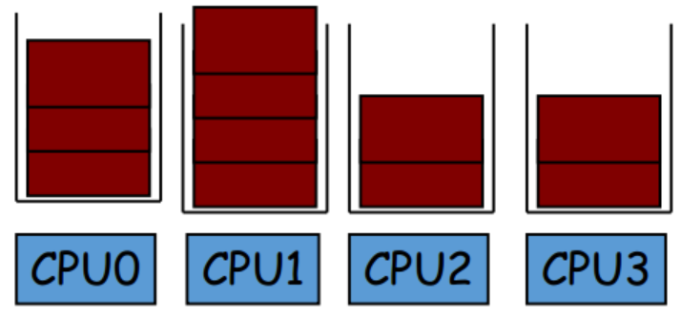
2. Bag-of-Tasks on Multi-Processors

Slide 48
3. DAGs Scheduling on Heterogeneous Processors
P1
P2
P3
Given: processing time of every task on every processor, communication time on the edges
To determine where and when each task is executed
Objective: make-span …

Slide 49
4. Job Shop Problem (JSP) (np-hard)
J1
J2
J3
J4
J5
J1
J2
J4
J3
J5
P1
P2
P3
Given: processing time of every job on every processor
Constraint: every job is executed by every processor exactly once
Objective: make-span …

Slide 50
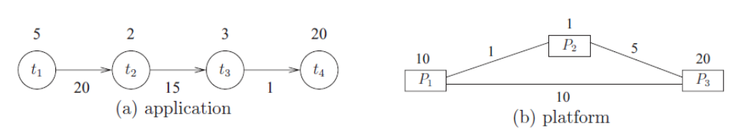
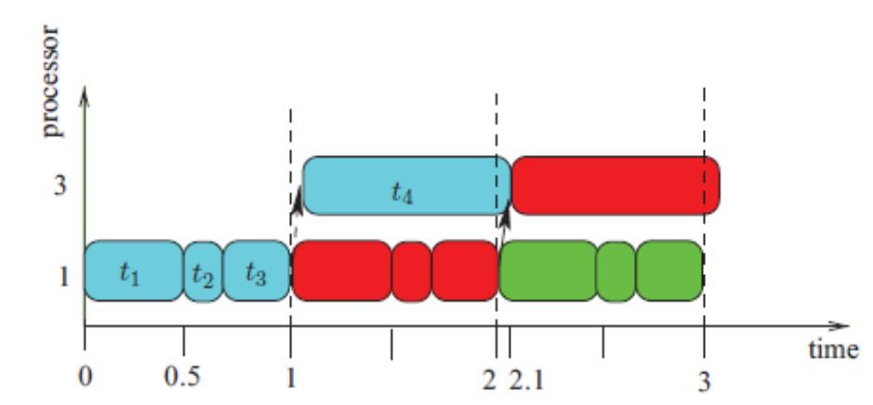
5. Periodic tasks scheduling
The tasks are released periodically and executed in pipeline
Make-span: 2.1
Throughput: 1

Slide 51
P/NP/-Complete/Hard
P ：能"快速解出来"
  直觉：存在一个算法，能在多项式时间内给出答案。
  多项式时间：比如 O(n)、O(n²)、O(n³)。对比 O(2ⁿ)、O(n!) 这种"爆炸式"增长。
  例子：排序、最短路径、判断一个数是不是偶数。
NP = 给你一个候选答案，能在多项式时间内检查它对不对。
经典例子：数独 / 拼图
  让你从零解一个 9×9 数独 → 可能很难；
  但给你一个填好的数独，让你检查是否符合规则 → 几秒钟就能验完。
  这就叫"解可能很难，但验证很容易"。
给你一个调度方案，问"这个方案能不能在 deadline 前完成？“
  你只要模拟一遍就能验证，很快。但从零找这个方案，可能很难。
P ⊆ NP（能快速解的，当然也能快速验证）；
但 P 是否等于 NP，是计算机科学最大的未解之谜（千禧年难题之一）。

Slide 52
P/NP/-Complete/Hard
NP-Complete = (它属于 NP)+ (NP 里所有问题都能归约到它)
归约
如果问题 A 能"翻译"成问题 B，而且翻译本身很快，那么：
B 能解 → A 也能解；
A 很难 → B 也至少一样难。
NPC 的意义：
它们是 NP 里"最难"的问题；
只要任何一个 NPC 问题找到多项式算法，那么 P = NP（所有 NP 问题都能快速解）；
至今没人做到，所以大家普遍认为 P ≠ NP，NPC 问题没有已知的多项式最优算法。
经典 NPC 问题：SAT（布尔可满足性）、旅行商问题的判定版、背包问题的判定版、图着色

Slide 53
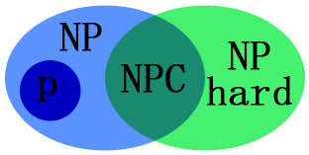
P/NP/-Complete/Hard
NP-hard: 不是说"做不了"，而是说"很难保证在合理时间内找到最优解“
  至少和 NP 里最难的问题一样难
  但不一定属于 NP
  NP-Hard 问题可能连验证都做不到。
所有的 NP-Complete 问题都是 NP-Hard
但 NP-Hard 不一定是 NP-Complete

Slide 54
如何证明一个问题是NP-Hard
NP-Hard 的定义是“NP 里所有问题都能归约到它”。
不需要真的去归约每一个 NP 问题（不可能） 。
找一个已知的 NP-Hard 问题，把它归约到你的问题。
归约有传递性：所有 NP 问题 → 已知 NP-Hard 问题 → 你的问题。既然所有 NP 问题都能到已知 NP-Hard 问题，而它又能到你的问题，那么所有 NP 问题也都能到你的问题。所以你的问题也是 NP-Hard。
你想证明“搬钢琴很难”。
你已知“搬沙发”是 NP-Hard。
你展示：如果谁能搬钢琴，那他就一定能搬沙发（搬钢琴的过程里包含了搬沙发）。
所以搬钢琴至少和搬沙发一样难 → 搬钢琴也是 NP-Hard。

Slide 55
如何证明一个问题是NPC
证明验证这个问题的解是多项式的
证明这个问题是NP-Hard

Slide 56
Similar Terminologies
Resource allocation
Resource scheduling
Task assignment
Task placement
Task allocation
The problems above are considered as the special cases/instances of the scheduling problem.

Slide 57
Categories of Scheduling Algorithms
Algorithms to solve optimization problems
Mathematical programing, i.e., integer programming, linear programing
Evolutionary algorithms, i.e, GA, PSO, Ant colony
Simple and competitive heuristics, i.e., list scheduling
Machine learning based algorithm, i.e., deep reinforcement learning

Slide 58
Scheduling Method: System Considerations
Machine centric approach
  Scheduling is triggered when a machine becomes idle
  For each idle (空闲) machine, select the task according to some policies, e.g.,
    First-Come-First-Serve (FCFS),
    Shortest Job First (SJF),
    Earliest Deadline First (EDF)
    Job with the longest waiting time first, …
Task centric approach
  Scheduling is triggered done when a new task arrives
  For each scheduled task, select the machine according to some policies, e.g., earliest finished time, …

Slide 59
Summary
Performance is about the management of system resources in the face of particular types of demand to achieve acceptable timing behavior.
Performance can be measured in terms of throughput and latency for both interactive and embedded real time systems.
Performance can be improved by reducing demand or by managing resources more appropriately.

